Slide 2
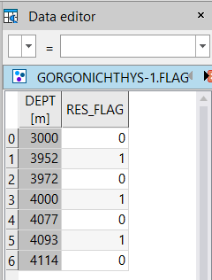
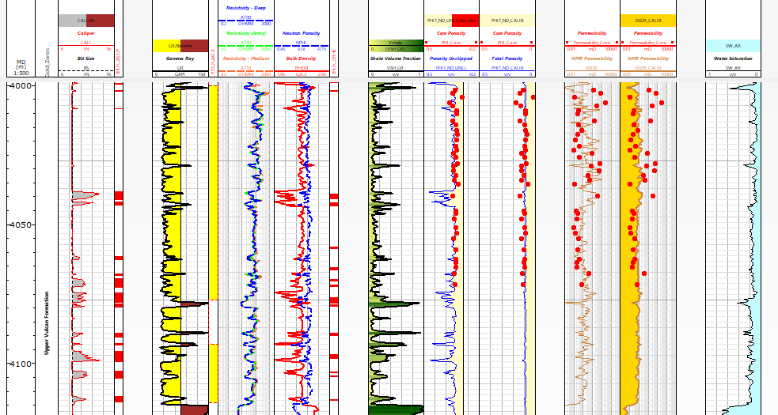
Main Reservoir Interval
4000-4077m -> later for good core calibration changed it to 4016-4077
Wherever we have bad bore hole (washout) porosity log is showing spiked up values
Density log-> low
Porosity log-> high (hence PHIT_ND spikes)

Slide 3
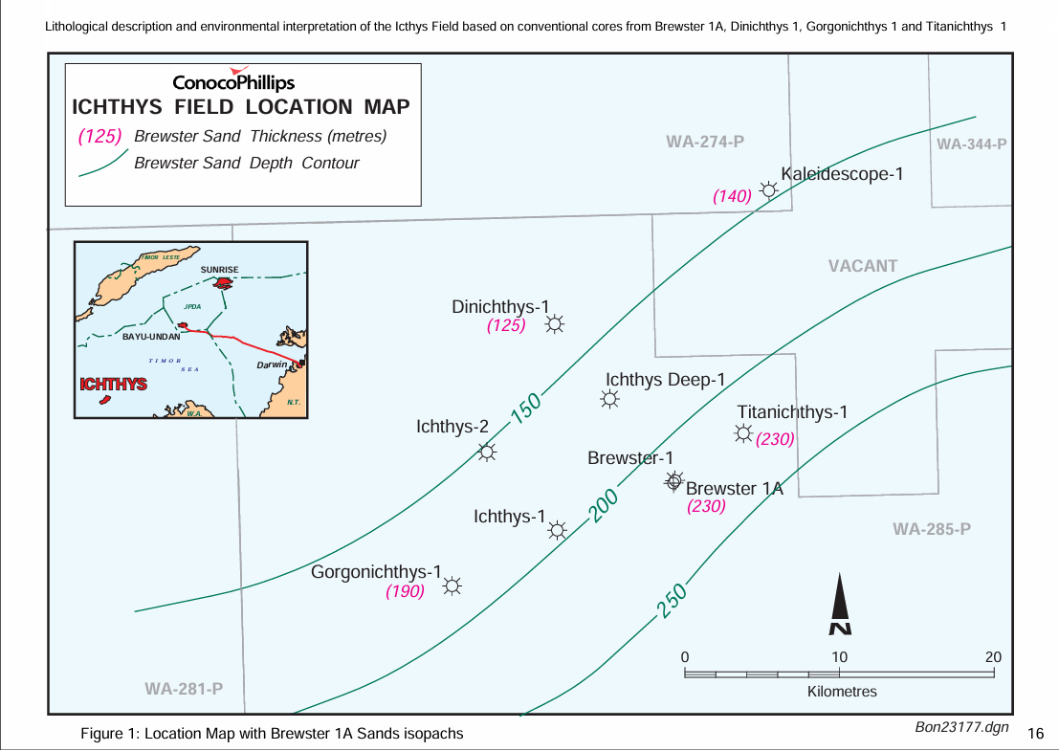

Slide 4
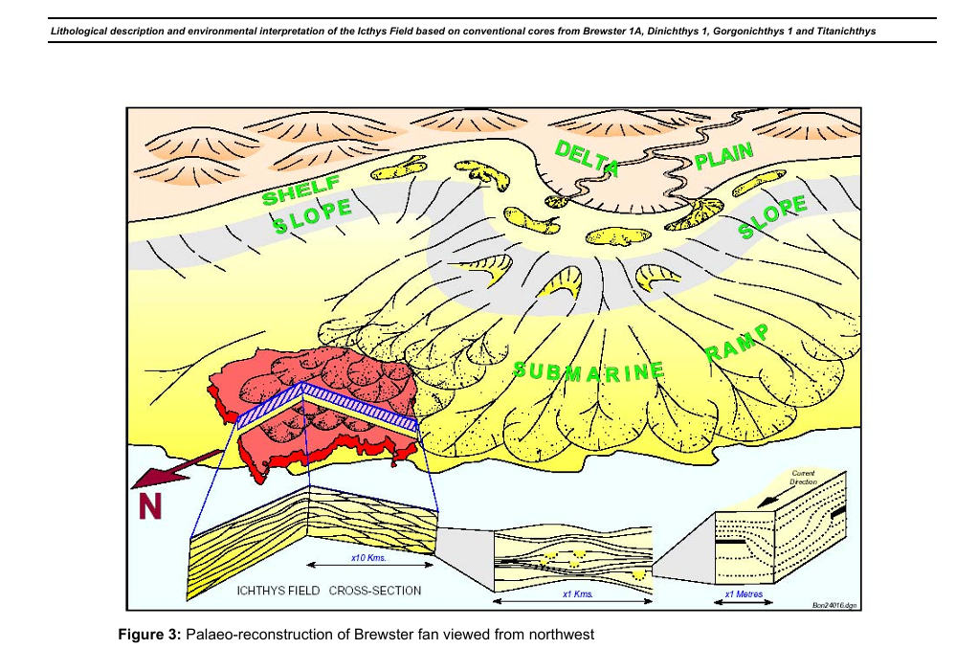

Slide 5
